Slide 1










Chongqing University of Technology
ATAI
Advanced Technique of Artificial Intelligence
Chongqing University of Technology
CIKM_2021
Code: github.com/declare-lab/ASTE-RL
Hongyang Song

Slide 2
Outline
Motivation
Approach
Experiments
Conclusion

Slide 3
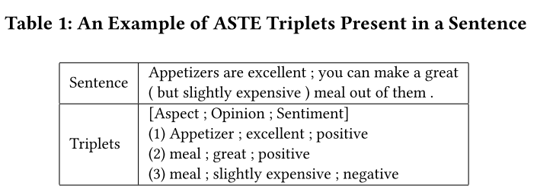
Motivation
Appetizers are excellent ; you can make a great ( but slightly expensive ) meal out of them .
Aspect: O O O O O O O O O O O O O O B O O O
Opinion: O O O O O O O O O O O B I O O O O O
Sentiment: O O O O O O O O O O O O O O O O O O

Slide 4
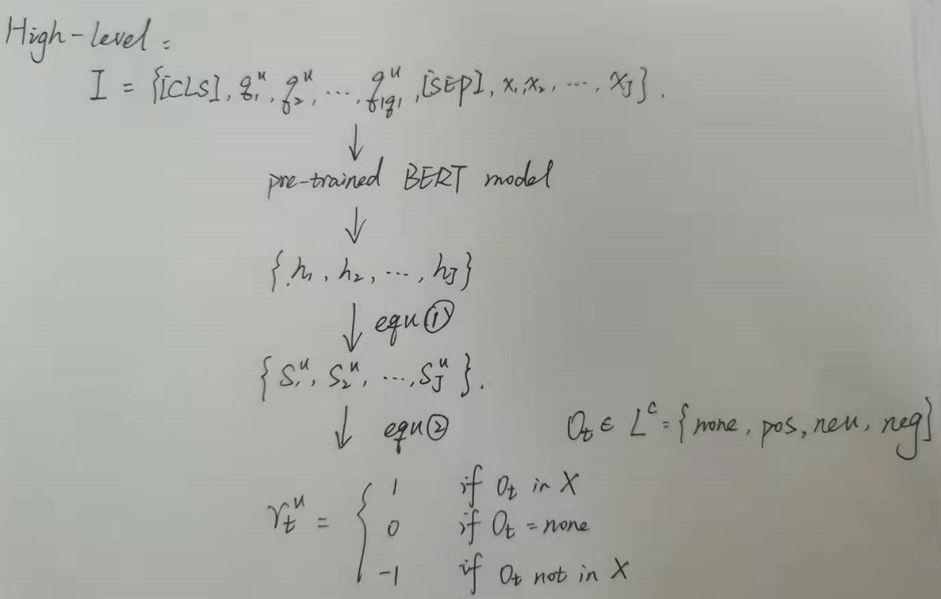

Approach
[CLS] Which tokens indicate sentiments relating pairs ofaspect spans and opinion spans? [𝑆𝐸𝑃] X
2016_emnlp_SQuAD: 100,000+ Questions for Machine Comprehension of Text

Slide 5
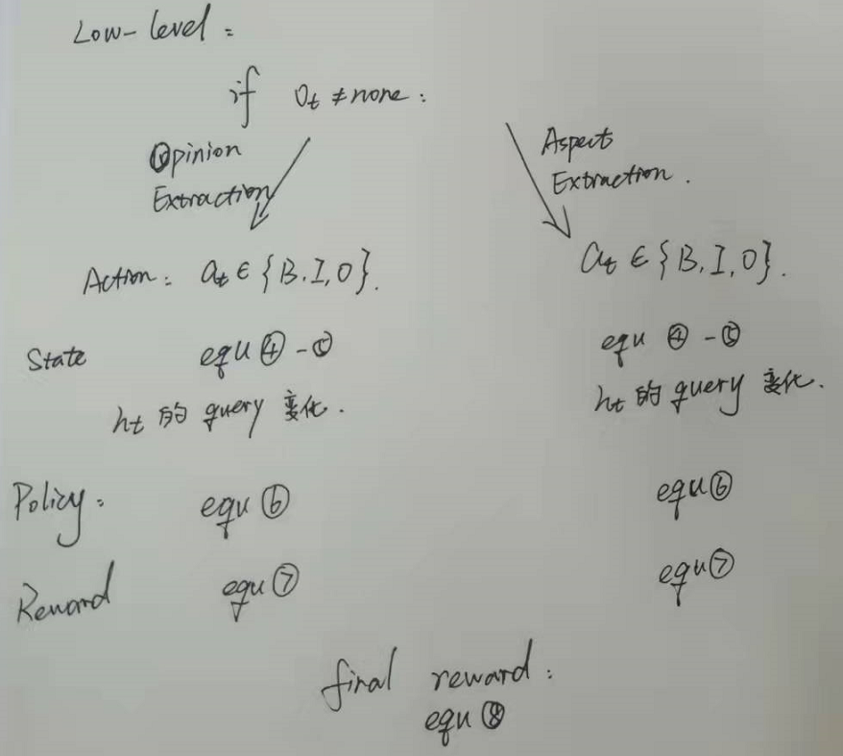



What is the opinion span for the o𝑡′ sentiment indicated at 𝑥𝑡′?
What is the aspect span for the o𝑡′ sentiment indicated at 𝑥𝑡′ ?

Slide 6
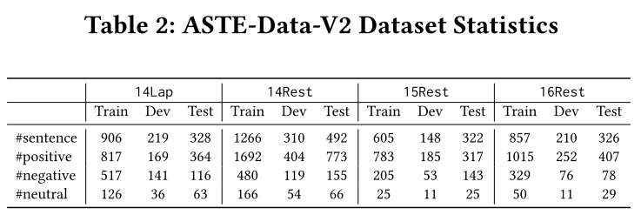
Experience

Slide 7
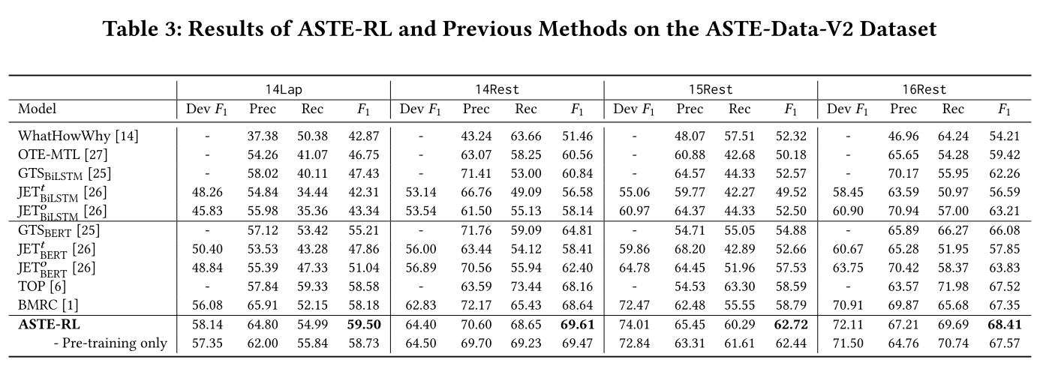
Experience

Slide 8
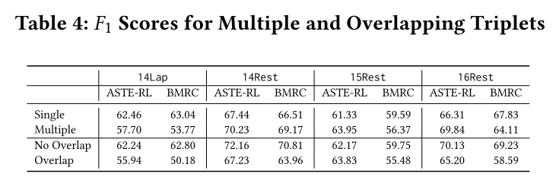
Experience

Slide 9
Thanks

